Slide 1

PYSPARK
MINI PROJECT
INVENTORY
MANAGEMENT
-Akash Sahu
-Harsh Gaur
-Bhagat Singh
-Amit Kumar
-Jatin Sharma

Slide 2

PROBLEM STATEMENT
2.1 OBJECTIVE
Development of a Analysis & Reporting System of Inventory Management.
2.2 ABSTRACT OF THE PROJECT
The project is to develop Analysis & Reporting System of Inventory

Slide 3



2.3 TECHNOLOGY
USED
Python
IDE – VsCode
PySpark

Slide 4

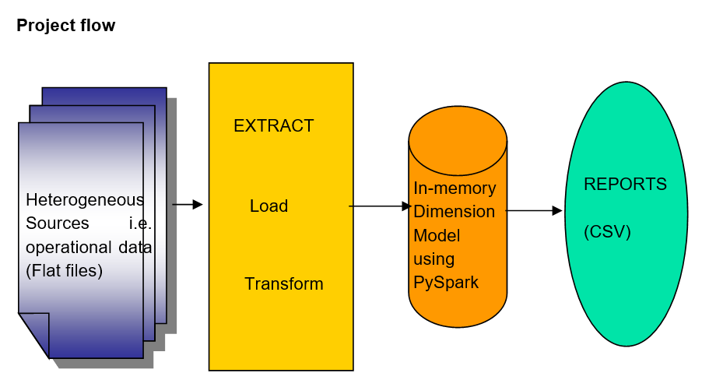
PROJECT
FLOW

Slide 5

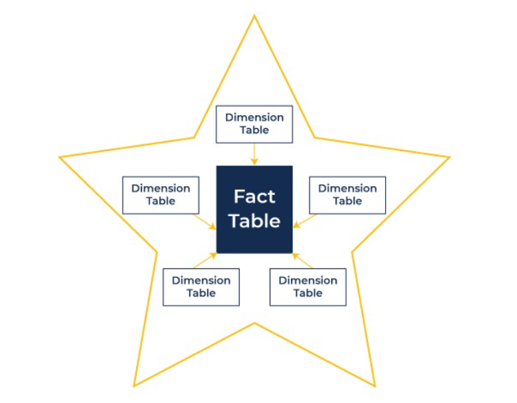
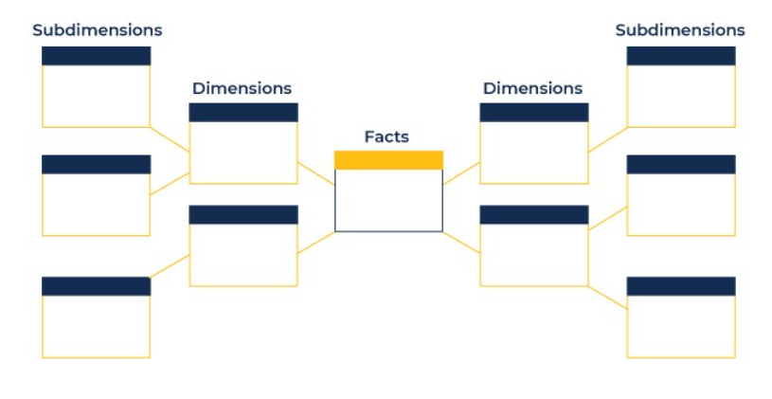
Star Schema
Snowflake schema
Multi-layered structure with normalized Dimension Tables
Fact Table linked to normalized Dimension Tables
More complex joins required for queries
Lower data redundancy
Better data integrity due to normalization
Simple, flat structure
Centralized Fact Table with denormalized Dimension Tables
Easier to understand and query
Less complex joins
Higher data redundancy

Slide 6
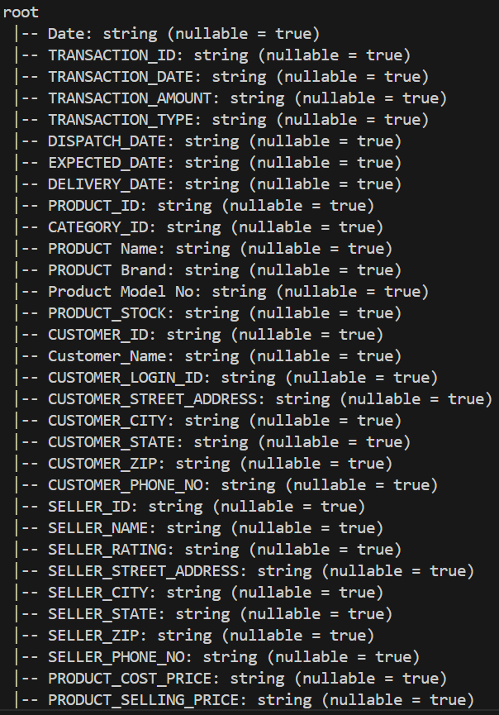
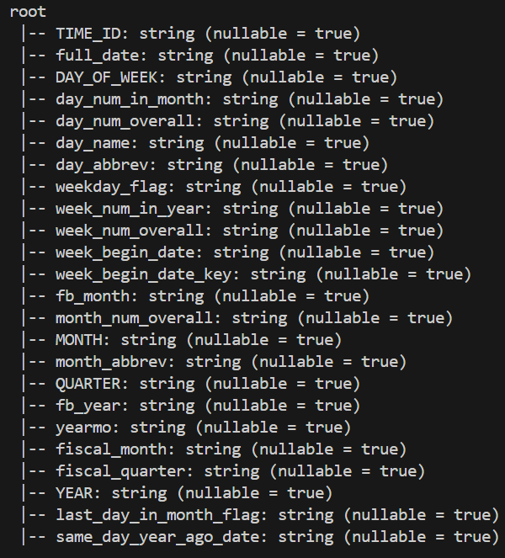
Schema Given

Slide 7
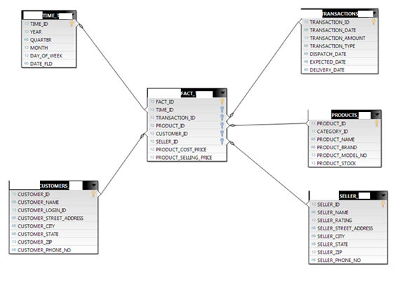

Slide 8
DATA TRANSFORMATION
FOR DATA WAREHOUSE
Load the Data
from CSV files
provided.
Populate Dimension tables and allocating unique IDS
Creating fact-table

Slide 9




REPORTS TO
BE BUILT

Slide 10
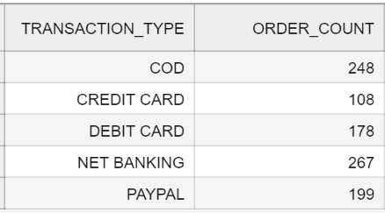
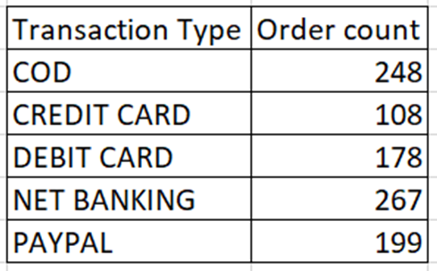
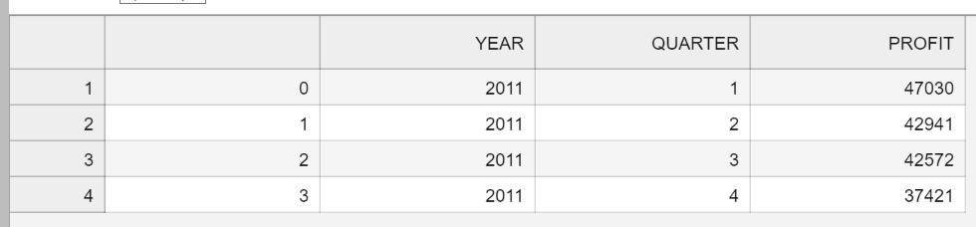
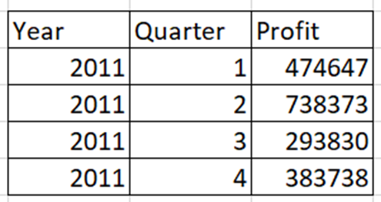

Slide 11
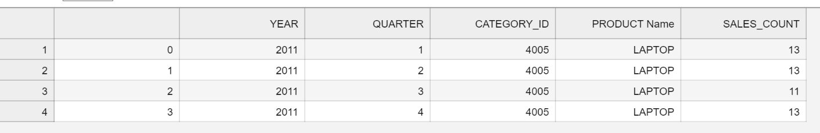
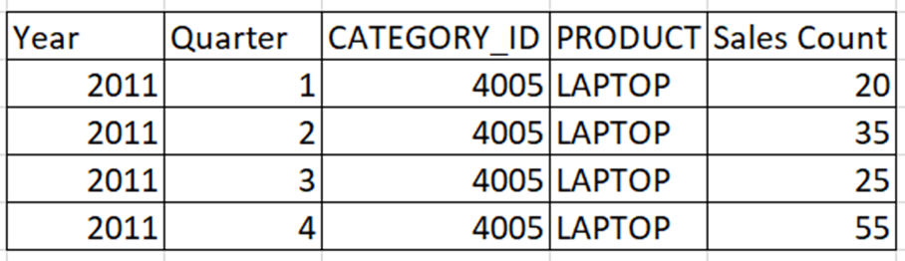
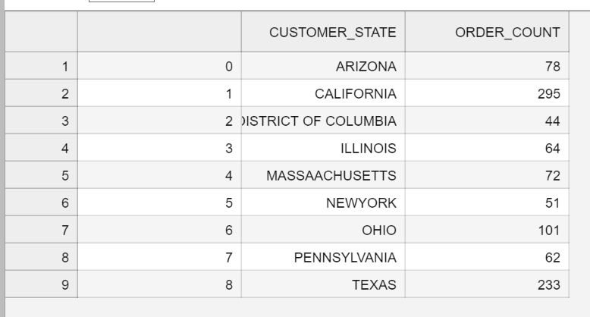
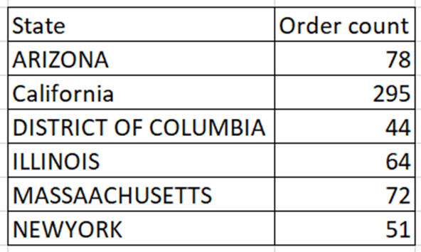

Slide 12
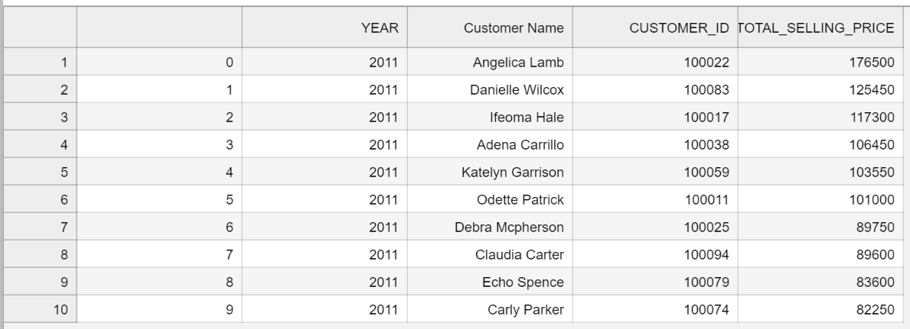
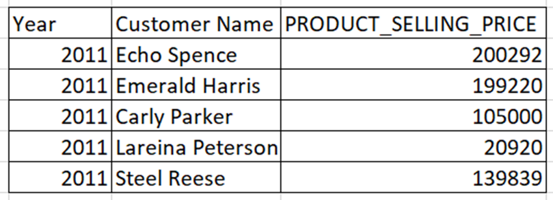

Slide 13
Challenges Encountered and Solutions
Corrupt data was identified, such as "Colleen's" customer ID being recorded as 100065 instead of the correct 100007 from previous rows.
We were unable to write a Spark DataFrame to CSV due to a PY4J error. This issue arose because the Py4J library could not be installed on Windows due to version compatibility problems

Slide 14

THANK YOU
Any Questions?

Slide 15
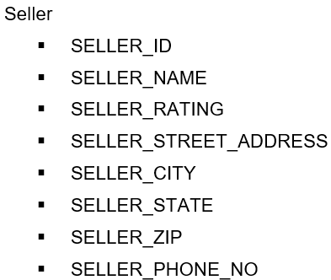
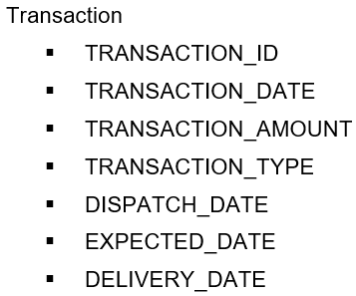
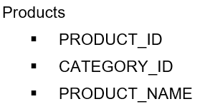
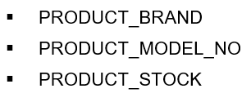
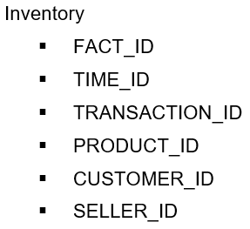
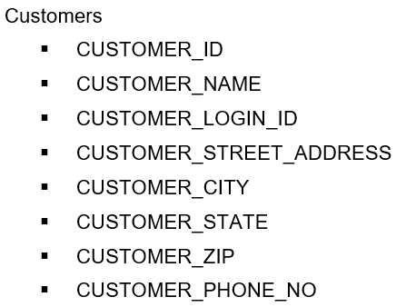
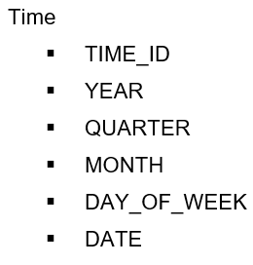


Slide 16
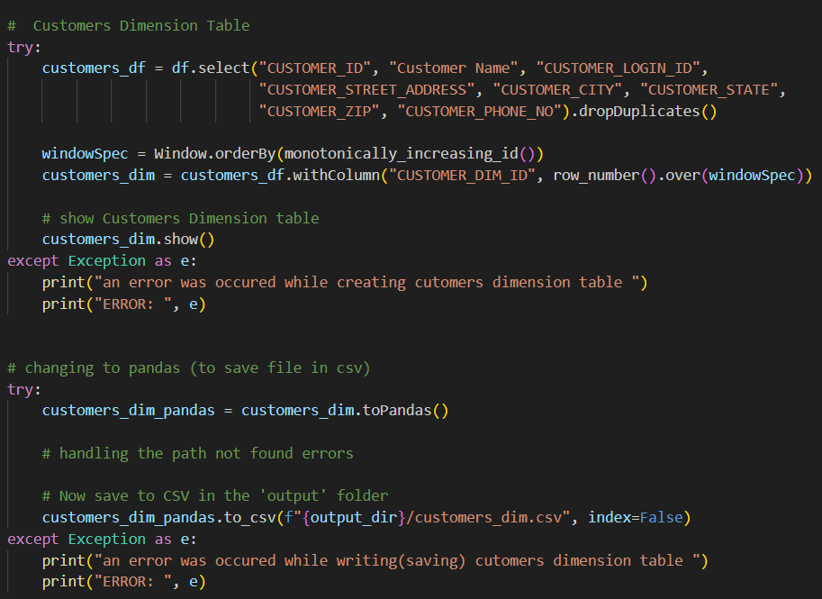
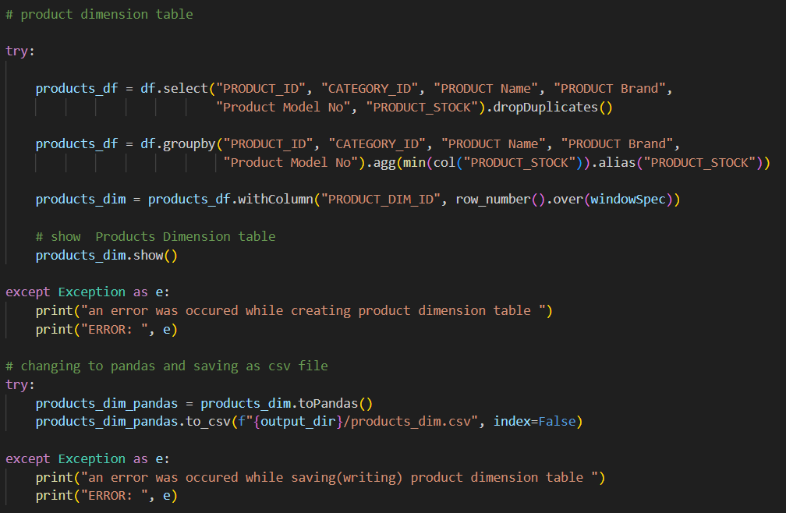

Slide 17
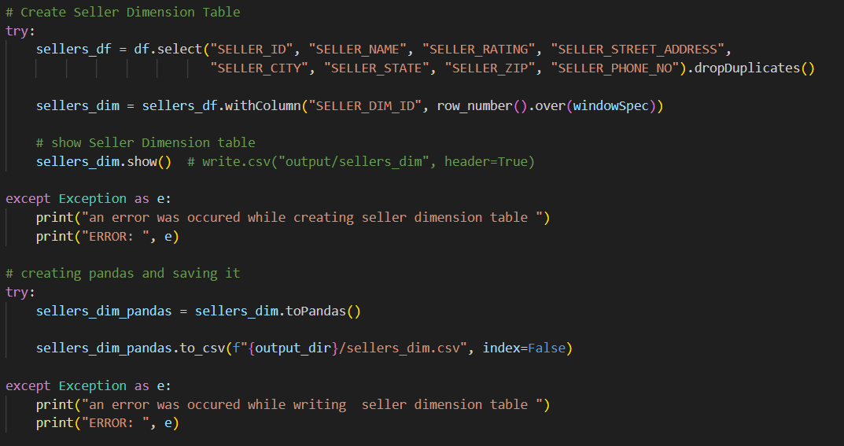
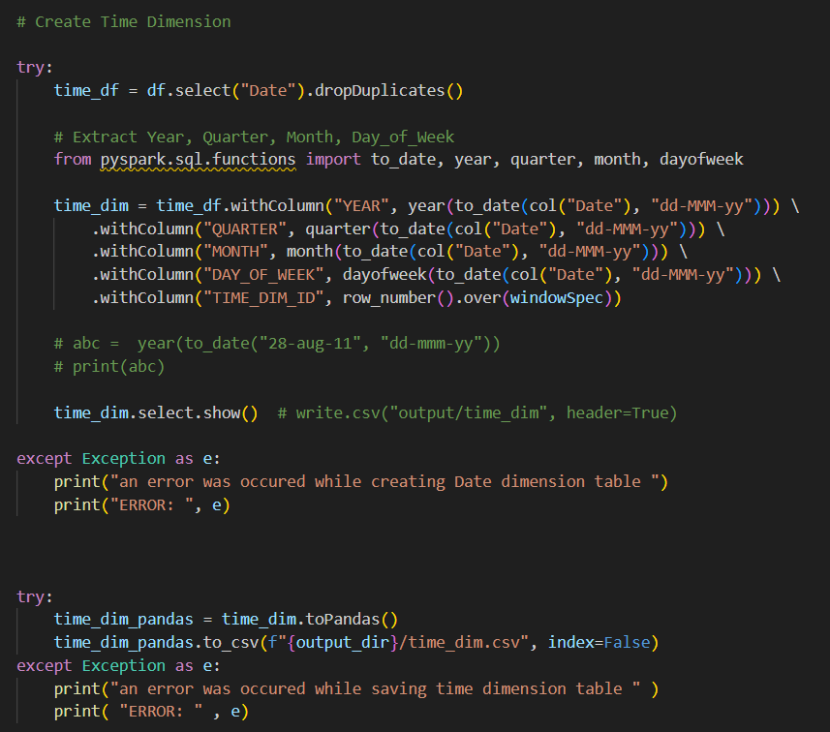

Slide 18
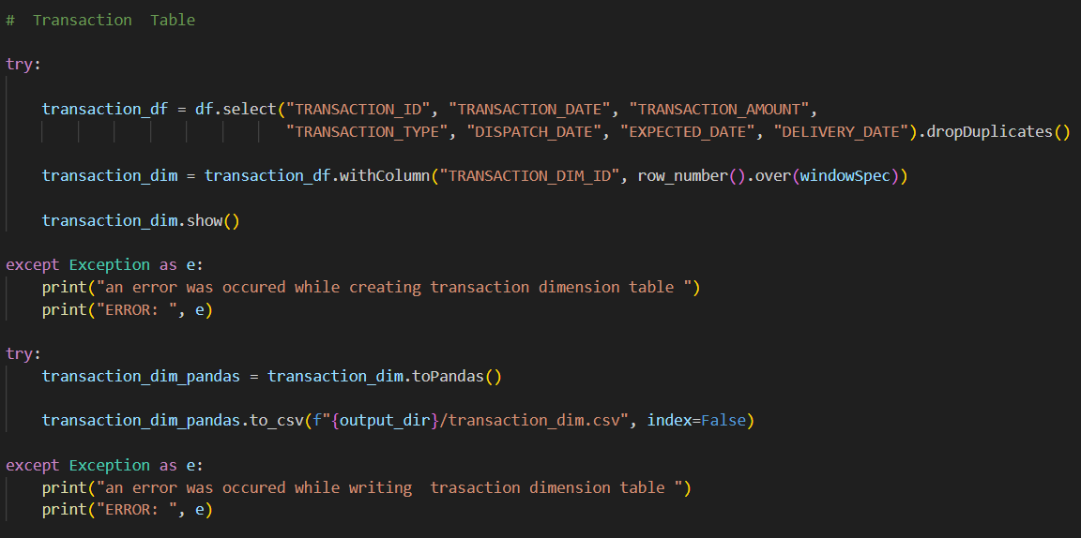
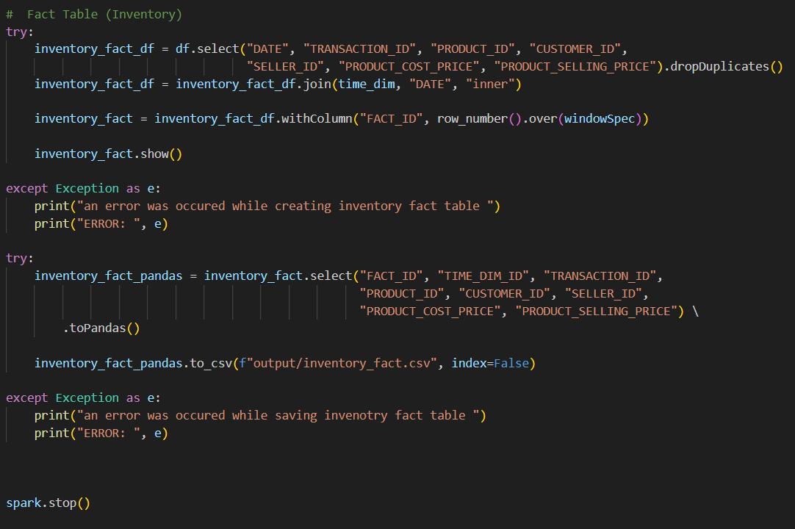

Slide 19
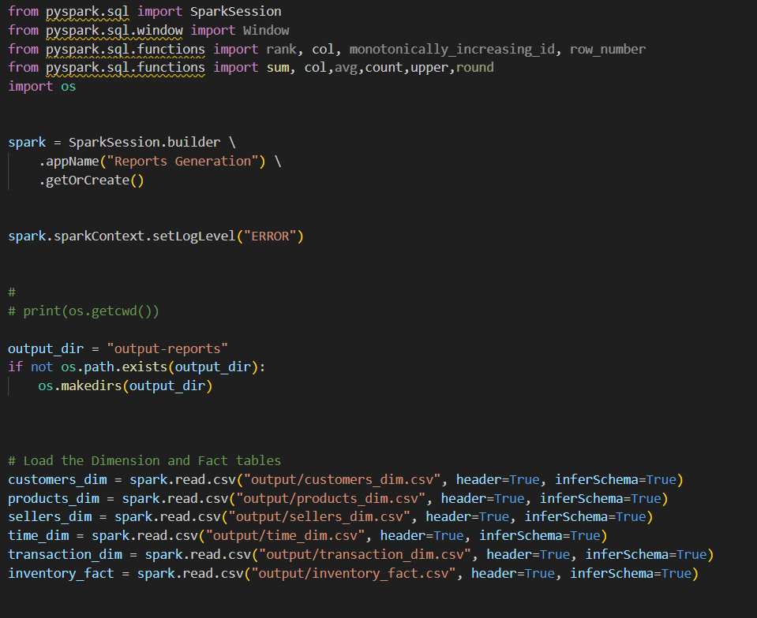
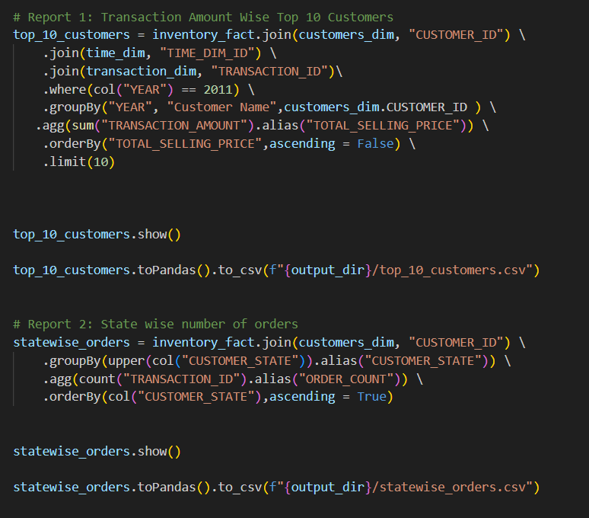

Slide 20
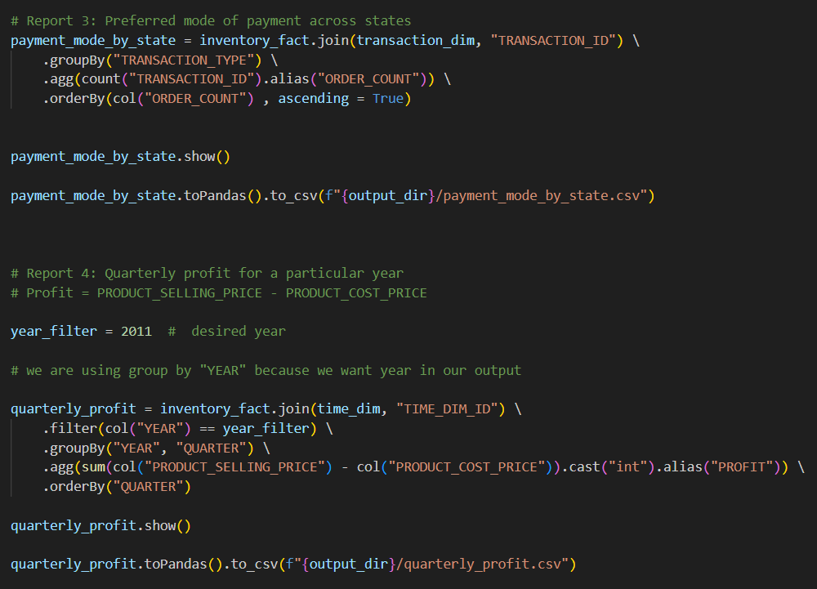
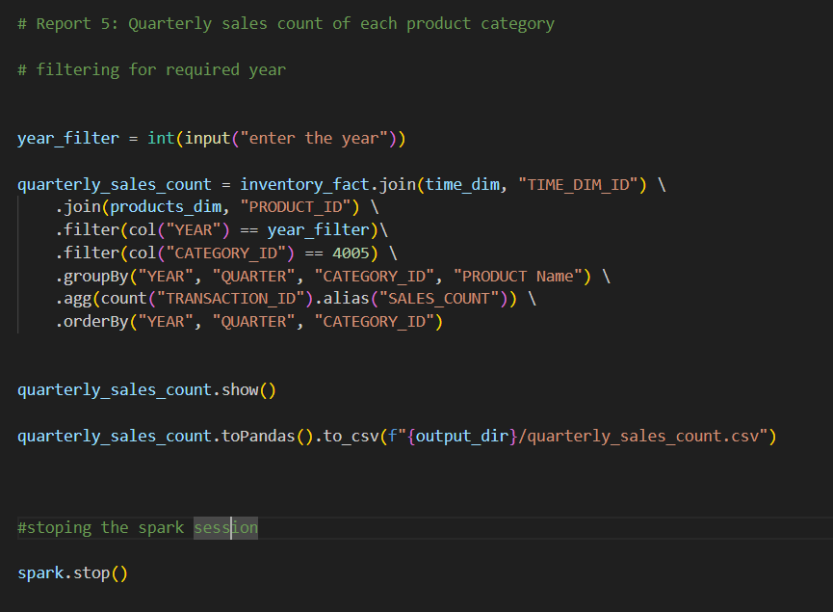

Slide 21
